Slide 1
SQL Grillen: Databases, Bratwurst & Beer
Migrating your local database to Azure SQL DB as you never seen it!
Marcos Freccia Data Platform MVP

Slide 2











Slide 3

Marcos Freccia
SQL Server DBA at Zalando SE
@marcosfreccia
marcosfreccia@outlook.com
http://marcosfreccia.com
Data Platform MVP
MCSA DBA & DEV SQL Server 2016 – Charter
MCSE Data Management and Analytics SQL Server 2016 – Charter
Originally from Brazil, now living in Berlin, Germany

Slide 4

Something that I have never seen it?

Slide 5
Agenda
Which tools are we going to use in this session?
Azure SQL Database DTU Calculator.
Database Transaction Unit (DTU). Why this is important?
Demos

Slide 6
Which tools are we going to use in this session?
Management Studio is your friend
Always install the latest updates!
https://docs.microsoft.com/en-us/sql/ssms/download-sql-server-management-studio-ssms
Microsoft Azure (off course)
Azure CLI or Cloud Shell or PowerShell Module
Python 3+
http://www.python.org/downloads
Database Migration Assistance – DMA
https://www.microsoft.com/en-us/download/details.aspx?id=53595
dbatools
https://dbatools.io/
Notes:
https://github.com/Microsoft/sql-server-samples/releases/tag/wide-world-importers-v1.0

Slide 7
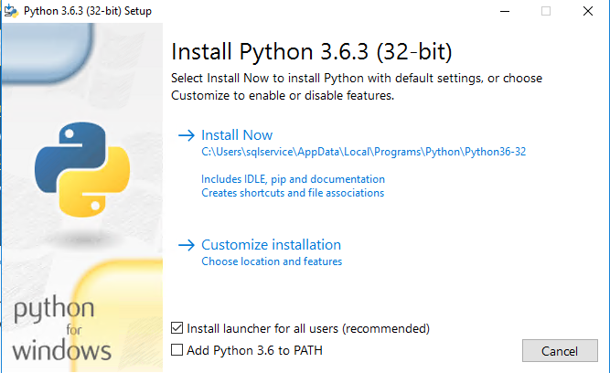
Setup Python and MSSQL Scripter
https://www.python.org

Slide 8
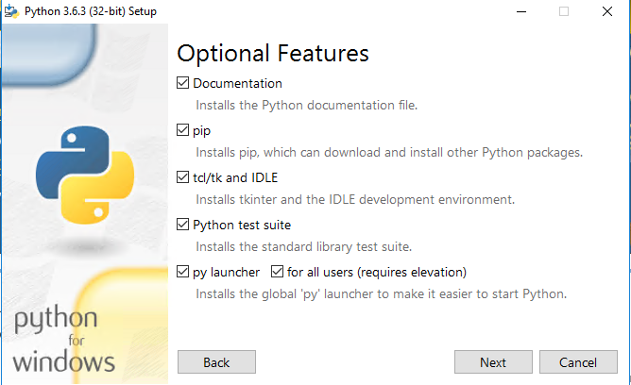
Setup Python and MSSQL Scripter
https://www.python.org

Slide 9
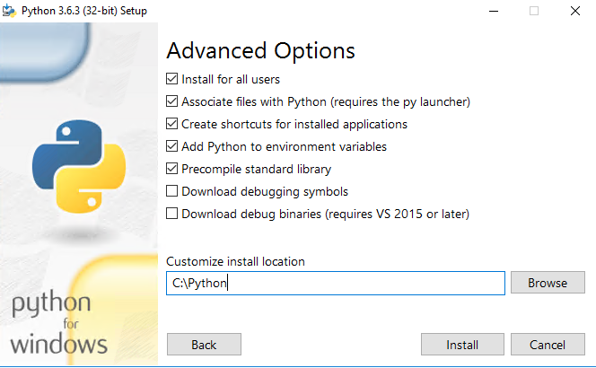
Setup Python and MSSQL Scripter
https://www.python.org

Slide 10
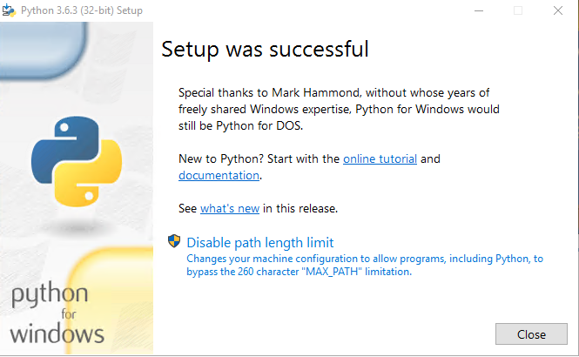
Setup Python and MSSQL Scripter
https://www.python.org

Slide 11
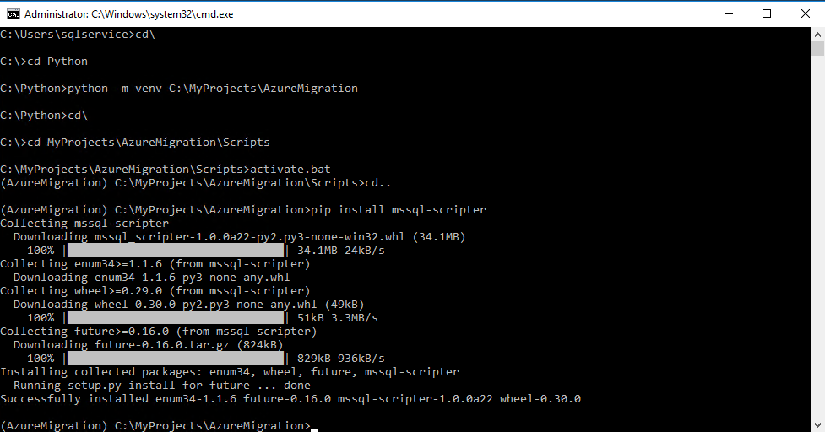
Setup Python and MSSQL Scripter
https://github.com/Microsoft/mssql-scripter

Slide 12
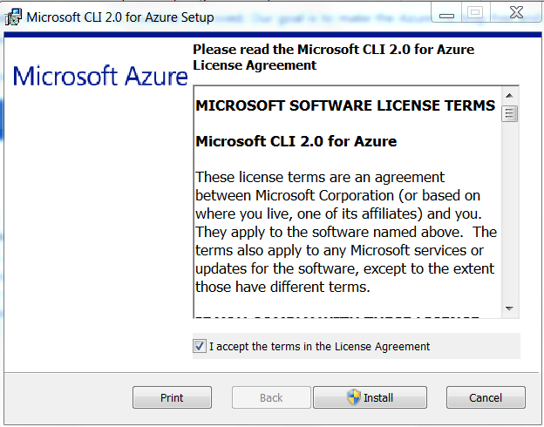
Setup Azure CLI
https://docs.microsoft.com/en-us/cli/azure/install-azure-cli-windows?view=azure-cli-latest

Slide 13
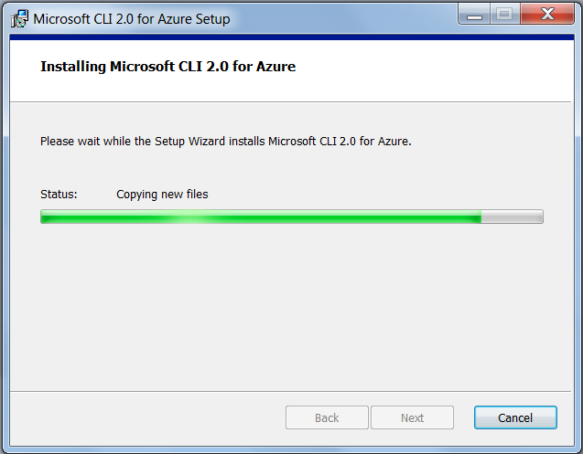
Setup Azure CLI

Slide 14
Setup Azure PowerShell Module
Open Powershell as Administrator
Type Install-Module AzureRM -AllowClobber

Slide 15
Setup dbatools
Open Powershell as Administrator
Type Install-Module dbatools and execute

Slide 16
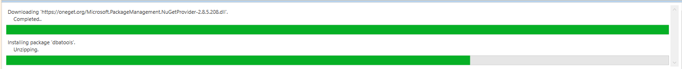
Setup dbatools
Open Powershell as Administrator
Type Install-Module dbatools and execute

Slide 17
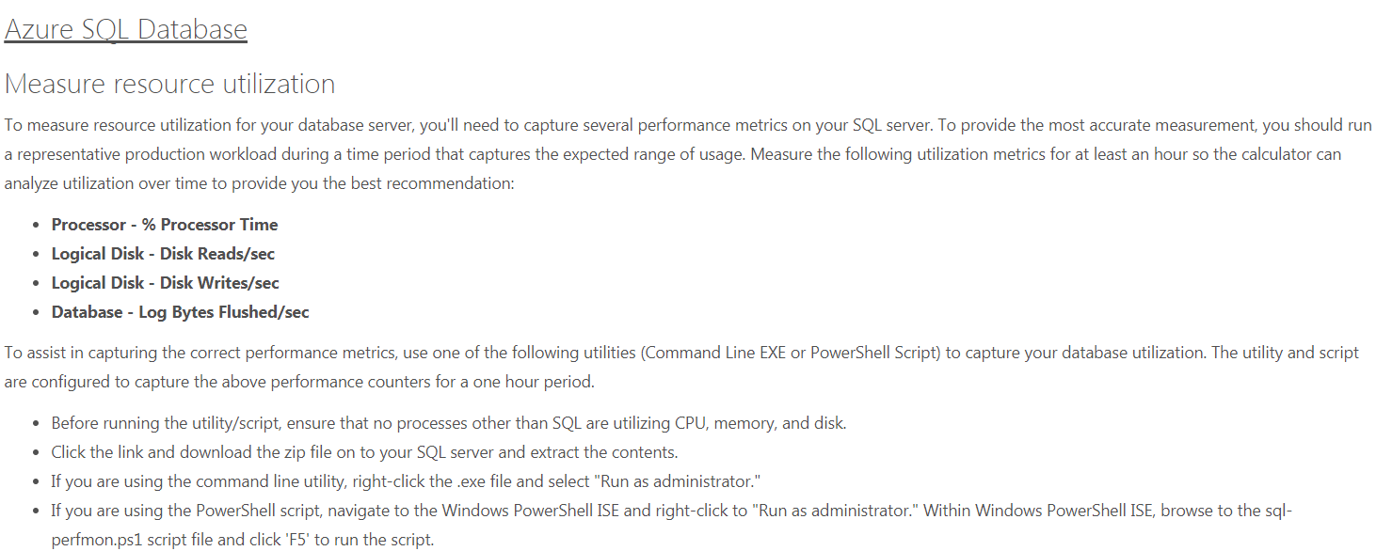
Database Transaction Calculator?
http://dtucalculator.azurewebsites.net/

Slide 18
Database Transaction Calculator?
http://dtucalculator.azurewebsites.net/

Slide 19
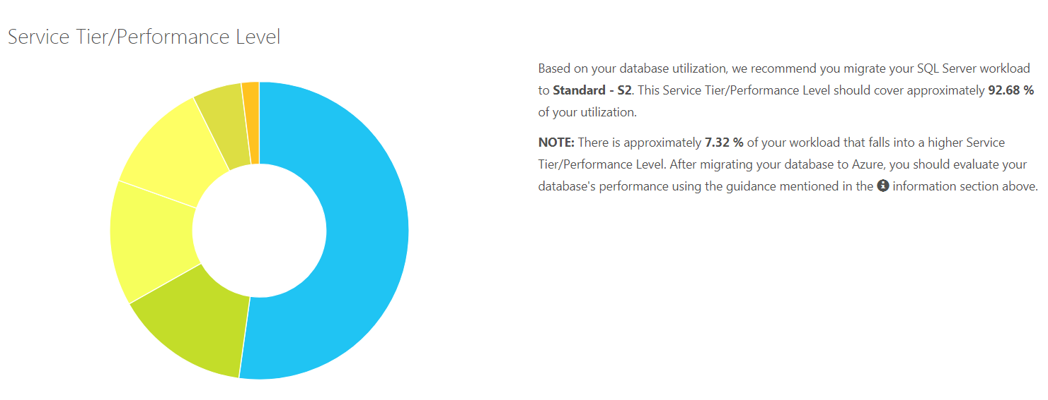
Database Transaction Calculator?
http://dtucalculator.azurewebsites.net/

Slide 20
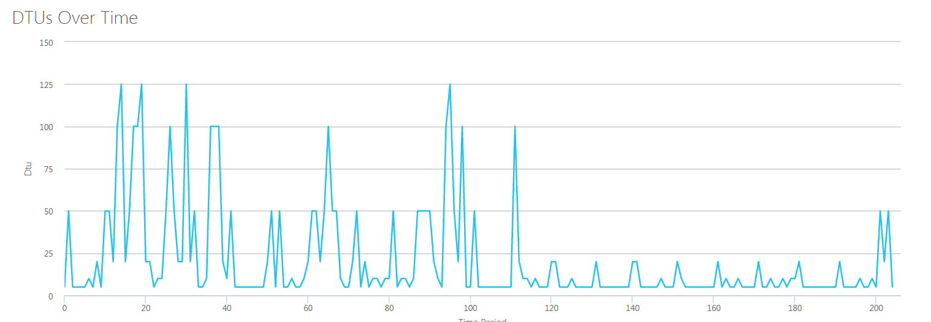
Database Transaction Calculator?
http://dtucalculator.azurewebsites.net/

Slide 21
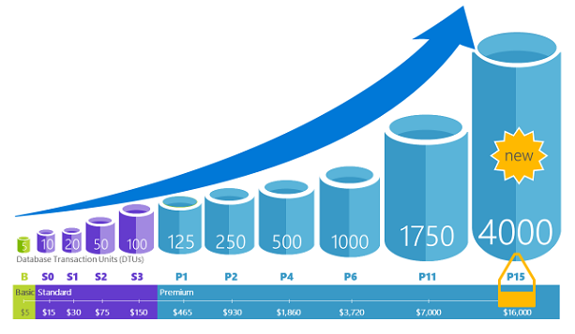
Database Transaction Unit (DTU). Why this is important?
https://docs.microsoft.com/en-us/azure/sql-database/sql-database-what-is-a-dtu

Slide 22
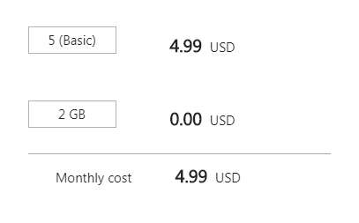
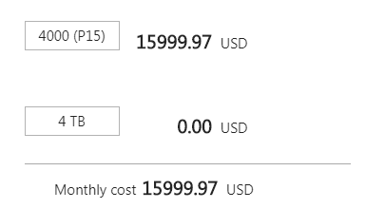
Database Transaction Unit (DTU). Why this is important?
https://docs.microsoft.com/en-us/azure/sql-database/sql-database-what-is-a-dtu

Slide 23


Slide 24
Looking for more resources?
https://docs.microsoft.com/en-us/azure/sql-database/sql-database-migrate-your-sql-server-database
https://docs.microsoft.com/en-us/cli/azure/install-azure-cli?view=azure-cli-latest
https://blogs.msdn.microsoft.com/datamigration/dma/
https://www.microsoft.com/en-us/download/details.aspx?id=53595
https://blogs.msdn.microsoft.com/sqlcat/2016/10/20/migrating-from-sql-server-to-azure-sql-database-using-bacpac-files/
https://github.com/Microsoft/sql-server-samples
https://azure.microsoft.com/en-us/pricing/details/sql-database/

Slide 25
Looking for Jobs?
Windows System Engineer
https://grnh.se/179e38631
PowerShell Driven
VMWare Experience
AD & DHCP & DNS & PKI
SQL Server Database Engineer – Soon!
WSFC & SQL Server Availability Groups
PowerShell driven
Python or C# are a plus!
Containers and Orchestration (Docker & Kubernetes)
SQL Server Resource Governor
Github/TFS/GitLab Experience

Slide 26
Marcos Freccia
@marcosfreccia
marcosfreccia@outlook.com
http://marcosfreccia.com

